Slide 1
TEAM NAME : Mind Install
PROJECT NAME : Doubt Solver
PROBLEM STATEMENT : EduTech

Slide 2
DESCRIPTION :
In this project we have made a doubts solving platform like discussion forum in which students can ask their doubts occured during online classes of different subjects to the respective teacher. So that the student's doubts can be solved in time effective manner using technique called communication threads.

Slide 3
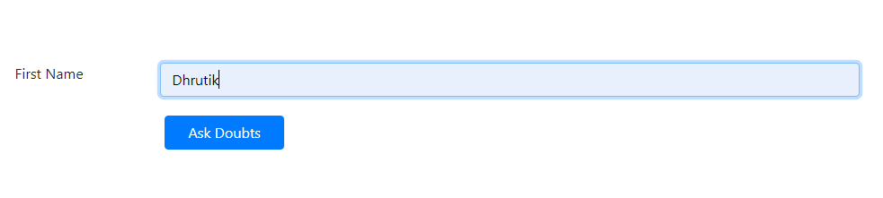
Interface
After cloning the repo, run "cd Doubt_Solver“
Then run "node index" to start the server
Navigate to "https://localhost:3000" where you will see form below.
Enter you name and click on “Ask Doubts”.

Slide 4
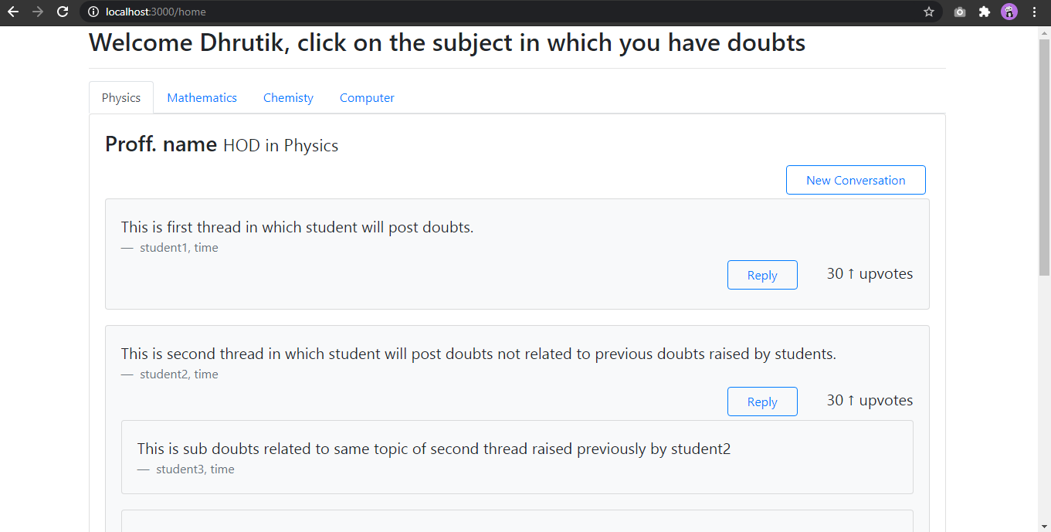
You will be directed to following page

Slide 5
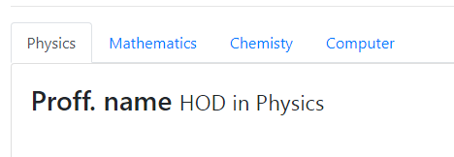
Student can goto subject in which they have doubts by clicking on subject name show on the tab.

Slide 6
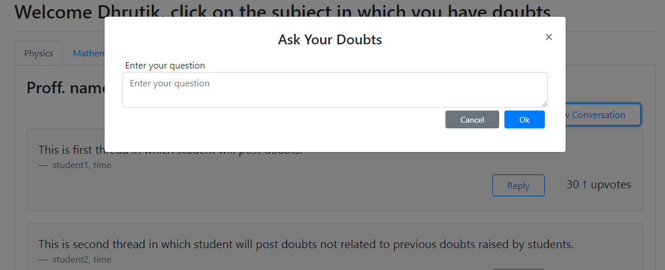
Posting Doubts
If you click on “New Conversation” button one pop up box will occure in which student can post there doutbs.

Slide 7
Techstack We Used :
Bootstrap
Node.js
Express
Socket.io

